Slide 1
ARTIFICIAL INTELLIGENCE
IT PEC-IT501B TH
TOPIC
SMART ATTENDANCE SYSTEM
GROUP 8
PRESENTED BY
Pinaki Subhra Bhattacharya (11500219053)
Sayon Islam (11500219054)
Soham Nandi (11500219057)
Randrita Sarkar (11500219058)

Slide 2

PROBLEM STATEMENT
Automatic Attendance System using Face Detection
OBJECTIVE
Face recognition based automatic attendance management system has been developed for the purpose of reducing the errors that occur in the traditional (manual) attendance taking system. This system will save the time, reduce the amount of work for the processors who has to manage the attendance and also it will replace the stationery material with electronic devices by which it will be in more secured manner, no one can access easily without the permission of attendance manager. It reduces the amount of human resource required for the purpose. Hence our system has been developed with the expected results.

Slide 3
01
02
03
Language
GUI KIT
Library
TECH-STACK
04
Modules
Python
TKinter
OpenCV
tk-tools, datetime,
shutil, csv,
numpy,pillow,pandas

Slide 4
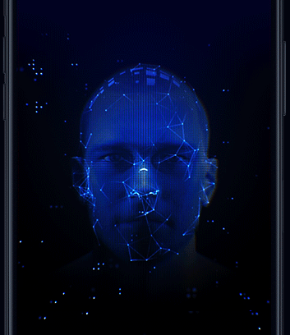
INTRODUCTION
Traditionally, student's attendances are taken manually by using attendance sheet, which is a time consuming event
Moreover it's very difficult to verify one by one student in a large classroom whether the authenticated students are actually responding or not
By using Face Detection and Face Recognition technology we can finish this task with zero effort. It's accurate and allows for high enrollment and verification rate. Let's understand the Approach of our project.

Slide 5
APPROACH
I
III
II
IV
FACE DETECTION
ATTENDANCEUPDATION
Dataset Creation
FACE RECOGNITION

Slide 6
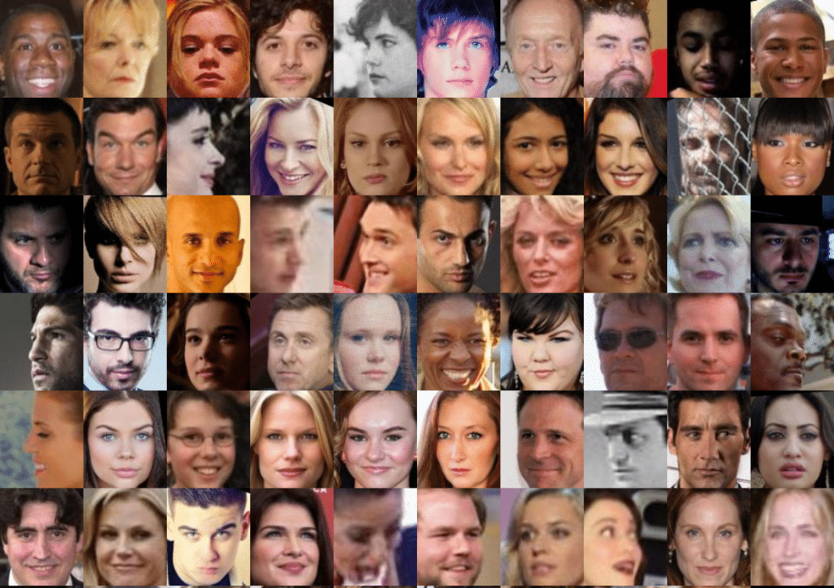
DATASET CREATION
Images of students are captured using a web cam. Multiple images of single student will be acquired with varied gestures and angles.
The images are cropped to obtain the Region of Interest (ROI) which will be further used in recognition process.
Next step is to resize the cropped images to particular pixel position.
Then these images will be converted from RGB to gray scale images. And then these images will be saved as the names of respective student in a folder

Slide 7
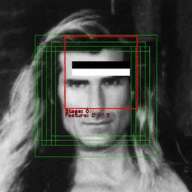
FACE DETECTION
Face detection here is performed using Haar-Cascade Classifier with OpenCV.
Haar Cascade algorithm needs to be trained to detect human faces before it can be used for face detection. This is called feature extraction.
The haar cascade training data used is an xml file haarcascade_frontalface_default

Slide 8

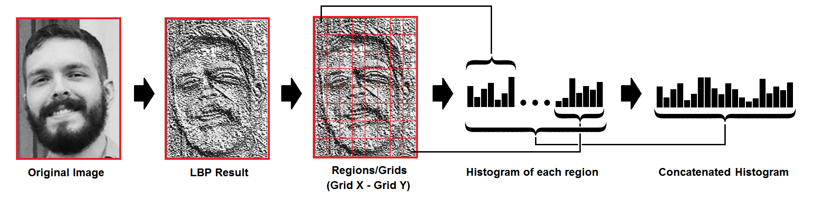
FACE RECOGNITION USING LBPH ALGORITHM
Face recognizer used in this system is Local Binary Pattern Histogram. Initially,
the list of local binary patterns (LBP) of entire face is obtained.
These LBPs are converted into decimal number and then histograms
of all those decimal values are made.
At the end, one histogram will be formed for each images in the training data

Slide 9
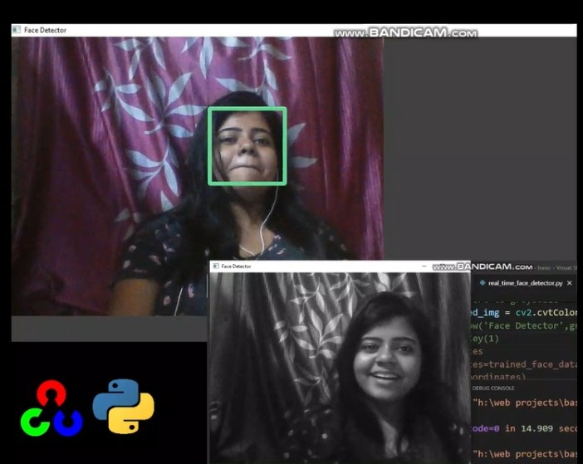
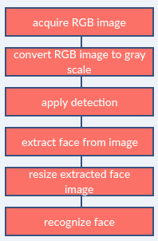
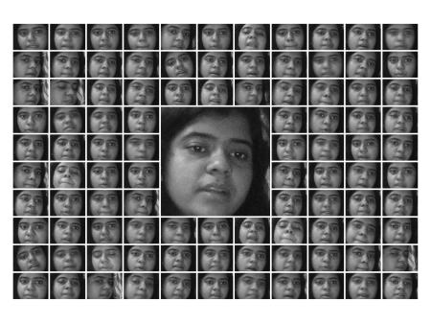
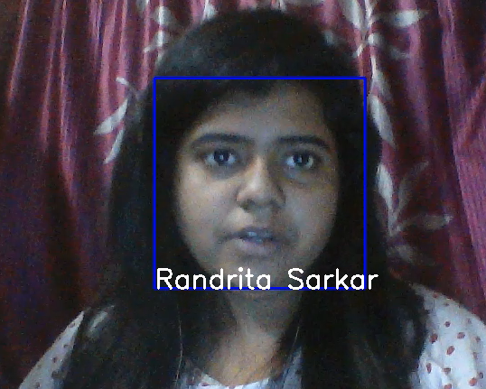
APPLICATION

Slide 10



Slide 11
BIBLIOGRAPHY
https://towardsdatascience.com/face-recognition-how-lbph-works-90ec258c3d6b
file:///C:/Users/DELL/Downloads/Face_Recognition_based_Attendance_Management_Syste.pdf
https://www.pyimagesearch.com/2021/04/05/opencv-face-detection-with-haar-cascades/

Slide 12

THANK YOU!

